Slide 1

Donutz Mode Switch Plugin
A Simhub plugin

Slide 2
Why this plugin?
Multiply the amount of virtual buttons of your wheels/button boxes
up to five rotary encoders can be configured as „mode switches“
each mode switch may control up to 12 buttons
While in VR be aware which mode is active
making use of Simhub properties which can be used in dashboards or overlays
Extension of Simhub‘s Control Mapper plugin
directly trigger Control Mapper roles
additional functions like iRacing chat commands (e.g. „IRCHAT:Hi!“)

Slide 3
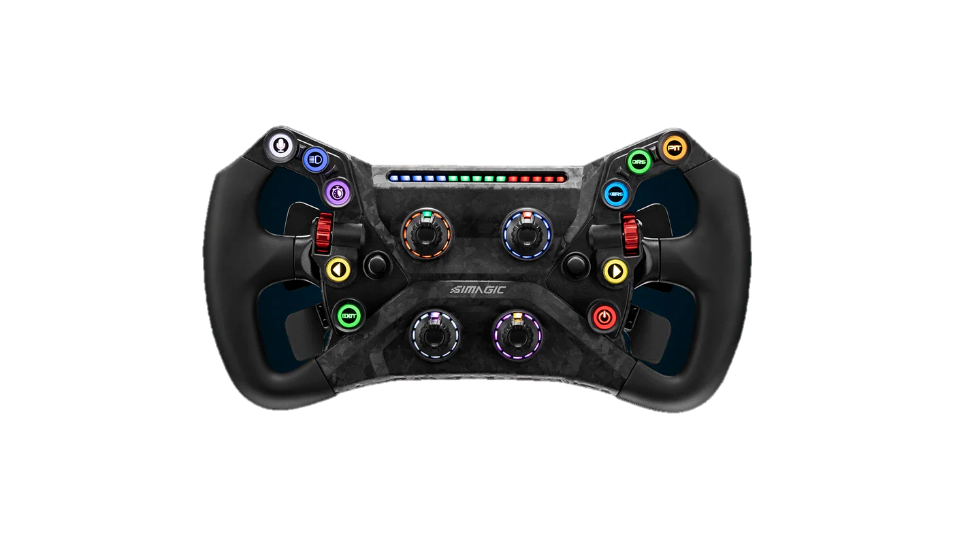
Example
Upper left rotary shall control the functionality of the left thumb dial Modes: Brake Bias
Car Dashboard Page
Upper right rotary shall control the functionality of the right thumb dial Modes: iRacing loudness
iRacing active reset
MAIRA Overall Scale
Image source: simagic.com

Slide 4
Properties
DonutzModeSwitcherPlugin.Switch[ID]AllowedModes
list of allowed modes as list of Ids Example: $prop("DonutzModeSwitcherPlugin.Switch1AllowedModes")
DonutzModeSwitcherPlugin.Switch[ID]AllowedModesString
list of allowed modes including current mode marked (as string) Example: $prop("DonutzModeSwitcherPlugin.Switch1AllowedModesString")
DonutzModeSwitcherPlugin.Switch[ID]ModeID
current mode ID Example: $prop("DonutzModeSwitcherPlugin.Switch1ModeID")
DonutzModeSwitcherPlugin.Switch[ID]Mode
current mode name Example: $prop("DonutzModeSwitcherPlugin.Switch1Mode")
DonutzModeSwitcherPlugin.Switch[ID]ModeCSV[x]
Current mode name separated by sub-fields
You can define more than one label in the mode name tag (separated by a colon ';'). This way you can address each sub-name
Example: let‘s pretend mode name is set as „ABS;ABS+;ABS-“ $prop("DonutzModeSwitcherPlugin.Switch1ModeCSV")[0] → „ABS“ $prop("DonutzModeSwitcherPlugin.Switch1ModeCSV")[1] → „ABS+“ $prop("DonutzModeSwitcherPlugin.Switch1ModeCSV")[2] → „ABS-“
DonutzModeSwitcherPlugin.SwitchAllModes
list of all modes
$prop("DonutzModeSwitcherPlugin.SwitchAllModes")[1].Name = mode name of mode 1
$prop("DonutzModeSwitcherPlugin.SwitchAllModes")[1].Action1 = role name of mode 1 / action1 (or button1 if you will)
$prop("DonutzModeSwitcherPlugin.SwitchAllModes")[1].Action2 = role name of mode 1 / action2 (or button2 if you will)

Slide 5
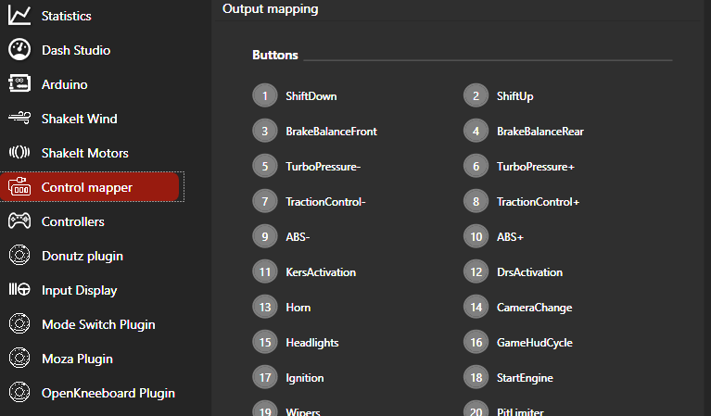
Step 1 – Assign Controls in Control Mapper

Slide 6
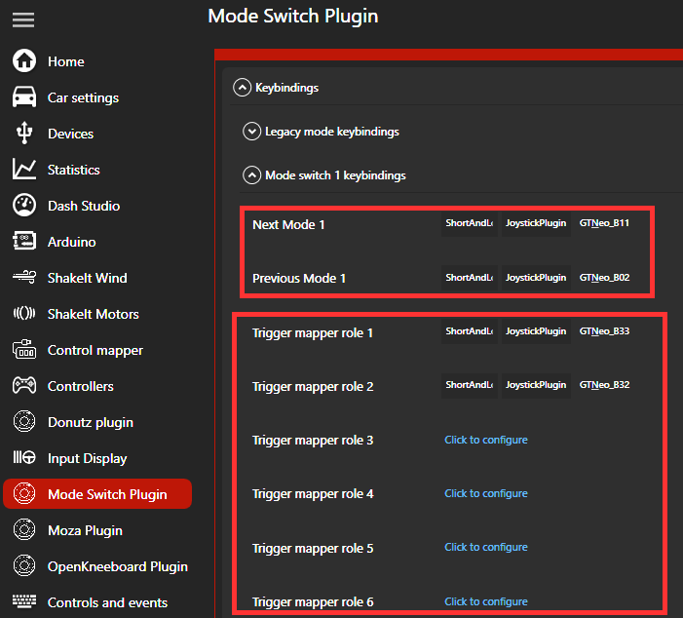
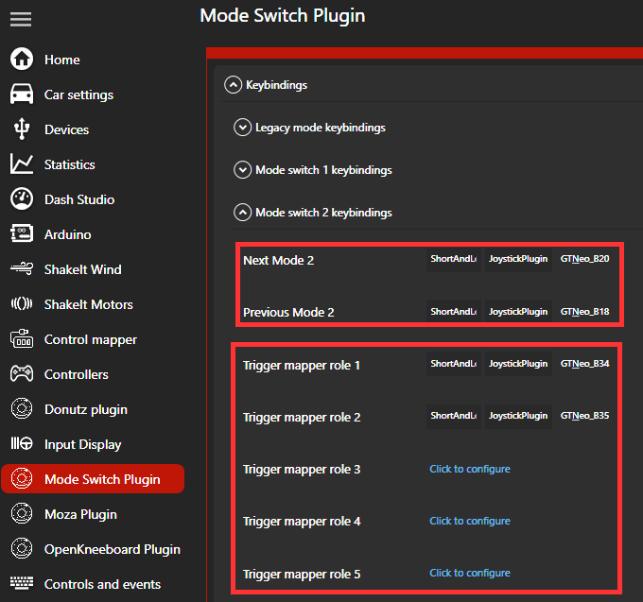
Step 2 – Assign Keybinds for Mode Switches and Buttons

Slide 7
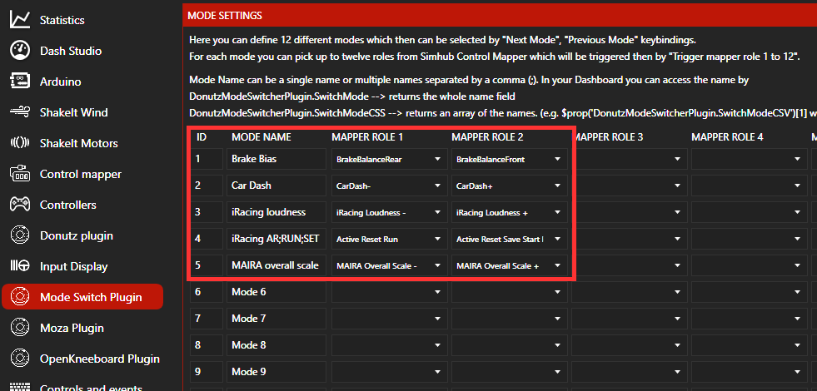
Step 3 – Define roles and assign Control Mapper roles

Slide 8
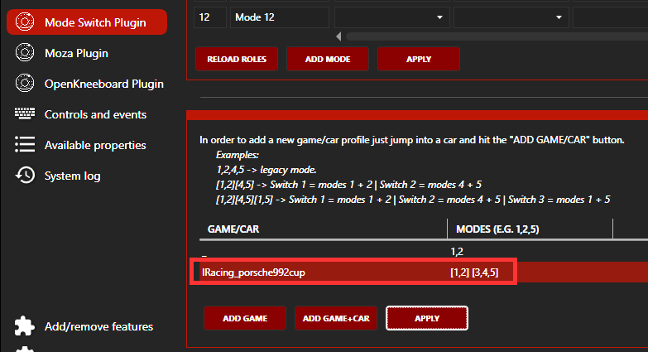
Step 4 – Assign Modes to Game/Car/Mode Switch
In this example if I jump into iRacing/Porsche Cup: - Mode Switch 1 (my upper left rotary) controls modes 1 and 2.
- Mode Switch 2 (upper right rotary) handles
modes 3,4 and 5.

